Slide 1
LLMs as Operating Systems: Agent Memory — Educational 15-Slide Outline
Exploring AI agent memory and OS design parallels
Notes:
AI-generated content may be incorrect. --- This presentation introduces the concept of large language models (LLMs) acting as operating systems, focusing on the role of agent memory. We will explore how AI agents manage memory, multitask, learn, and maintain security, drawing parallels with modern operating system design.

Slide 2
Agenda Overview
Title and Introduction to Agent Memory in LLMs
Memory Management and Caching in AI Agents
Multitasking, Learning, and Security Features
Security, Integration, and Future Vision
Notes:
Our journey begins with an introduction to agent memory in LLMs, followed by an exploration of memory management and caching in AI agents. We then examine multitasking, learning, and security features before concluding with integration and future visions for AI agents as operating systems of thought.

Slide 3
Title and Introduction to Agent Memory in LLMs
Notes:
This section sets the foundation by presenting the metaphor of LLMs as operating systems and outlining how agent memory plays a critical role in evolving AI capabilities.

Slide 4

LLMs as Operating Systems: Agent Memory — Abstract AI and OS Imagery for Cover Slide
LLMs as Operating Systems
Large language models function like operating systems, managing processes and resources for AI applications.
Agent Memory Importance
Agent memory enables contextual awareness and supports sophisticated AI decision-making processes.
Abstract AI Imagery
Abstract visuals help communicate complex AI concepts like memory and system integration effectively.
Notes:
--- We use abstract imagery to visualize LLMs as operating systems, emphasizing the importance of agent memory as a core component that supports AI decision-making and contextual awareness. Image source: Microsoft 365 content library

Slide 5

AI Agents Evolve with Memory, Echoing the Design of Modern Operating Systems
AI Memory Functionality
Memory enables AI agents to retain context and improve interactions by learning from past experiences.
Operating System Evolution
Modern operating systems evolve by managing resources and storing states to enhance user experience.
Enhanced User Interaction
AI agents use memory to provide personalized and context-aware user interactions over time.
Notes:
--- AI agents develop enhanced functionality through memory, similar to how modern operating systems evolve. This memory allows agents to retain context and improve user interactions over time. Image source: Microsoft 365 content library

Slide 6
Memory Management and Caching in AI Agents
Notes:
Here we delve into how AI agents manage memory and cache information, drawing direct analogies to operating system processes that handle RAM allocation and data prefetching for performance optimization.

Slide 7
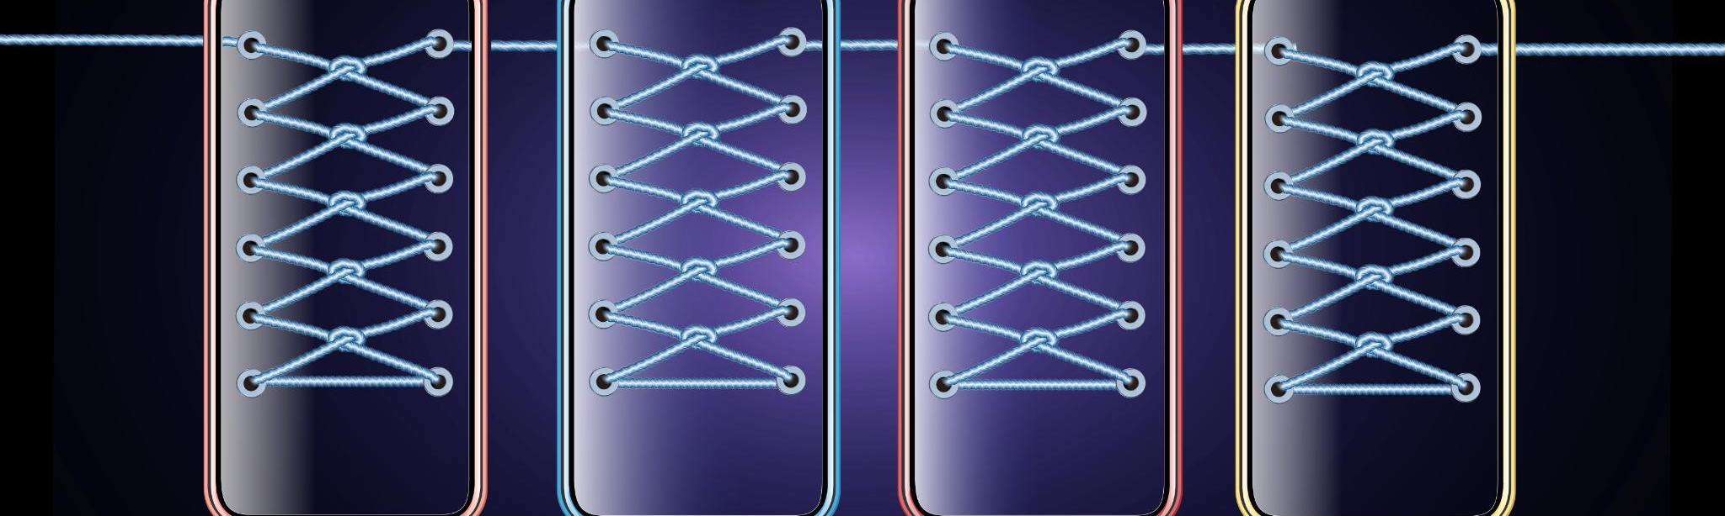
Operating Systems Allocate RAM; AI Agents Organize Past Interactions and Contextual Data
RAM Allocation by Operating Systems
Operating systems allocate RAM efficiently to manage multiple active processes and ensure optimal system performance.
AI Agents Managing Contextual Data
AI agents organize past conversations and contextual data to maintain meaningful and coherent user interactions.
Notes:
--- Operating systems allocate RAM to manage active processes, while AI agents organize past conversations and contextual data to maintain meaningful and coherent interactions. Image source: Microsoft 365 content library

Slide 8
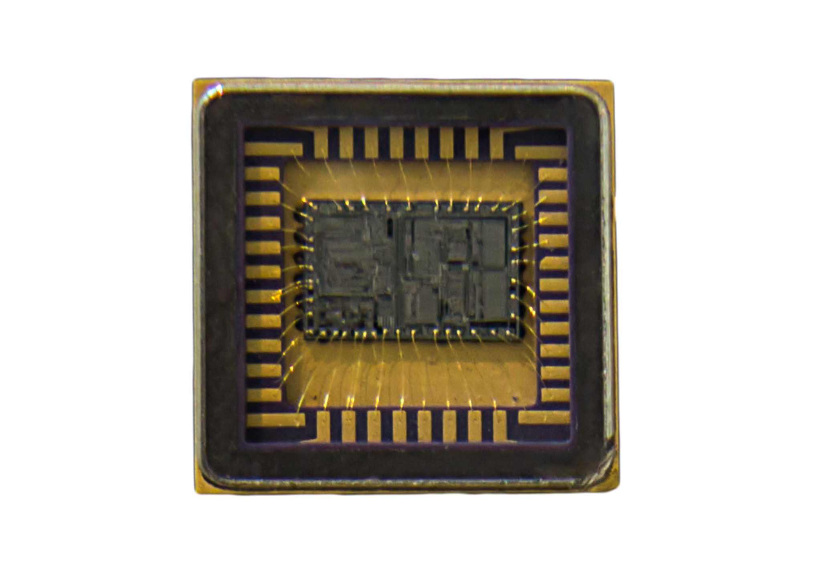
Visual Comparison: Memory Blocks Showing AI Storing Conversation States Similar to OS Memory
Operating System Memory Blocks
Operating systems use structured memory blocks to efficiently manage data and processes.
AI Conversation State Storage
AI agents store conversation states similarly to memory blocks, maintaining context throughout interactions.
Analogy for Understanding
Using memory blocks as an analogy helps explain how AI preserves context and manages information.
Notes:
--- This slide visually compares memory blocks in operating systems to how AI agents store the state of conversations, providing a clear analogy to aid understanding of agent memory structure. Image source: Microsoft 365 content library

Slide 9

OS Prefetches Data to Optimize Speed; Similarly, AI Agents Cache Frequent Information for Fast Responses
Operating System Prefetching
Operating systems prefetch data anticipating future needs to reduce latency in access times.
AI Agents Caching
AI agents cache frequently accessed information to accelerate response times and improve efficiency.
Speed Optimization Benefits
Prefetching and caching both optimize system speed by reducing data retrieval delays.
Notes:
--- Just as operating systems prefetch data to reduce latency, AI agents cache frequently accessed information to enable faster and more efficient responses. Image source: Microsoft 365 content library

Slide 10
Multitasking, Learning, and Security Features
Notes:
This section explores how AI agents multitask, learn continuously, and incorporate security measures, mirroring key features of operating systems.

Slide 11
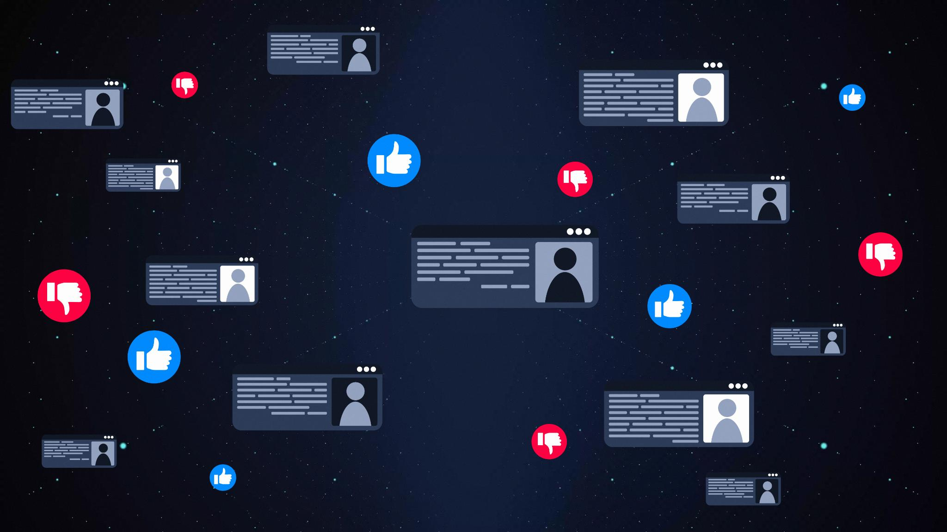
Operating Systems Excel at Multitasking; AI Agents Smoothly Handle Multiple Queries at Once
Operating Systems Multitasking
Operating systems manage multiple processes simultaneously to optimize resource use and performance.
AI Agents Parallel Queries
AI agents handle multiple user queries at once while maintaining context and accuracy.
Notes:
--- Operating systems manage multiple processes simultaneously, and similarly, AI agents efficiently handle multiple user queries in parallel without losing context. Image source: Microsoft 365 content library

Slide 12
Task Switching Visual: AI Juggling Conversations Like OS Process Management
AI Conversation Management
AI agents switch between multiple conversations efficiently to maintain smooth interactions.
Operating System Process Switching
Operating systems optimize resources by switching processes rapidly and efficiently.
Resource Optimization
Task switching in AI and OS improves system resource utilization and performance.
Notes:
--- A visual depiction illustrates AI agents switching between conversation threads gracefully, akin to how an operating system manages process switching to optimize resources. Image source: Microsoft 365 content library

Slide 13

OS Updates Regularly; AI Refines Through Continual Learning and Algorithm Updates
Operating System Updates
Operating systems regularly update to improve performance, add features, and enhance security for users.
AI Continual Learning
AI systems continuously learn and refine their algorithms through ongoing data input and updates.
Notes:
--- Operating systems receive regular updates for improved performance and security. Similarly, AI agents continually learn and update their algorithms to enhance accuracy and capabilities. Image source: Microsoft 365 content library

Slide 14
Security, Integration, and Future Vision
Notes:
The final section focuses on security aspects, integration efficiency, and future prospects for AI agents functioning as advanced operating systems of thought.

Slide 15

Operating Systems Defend Against Malware; AI Agents Secure Privacy and Protect User Data
Operating Systems Malware Defense
Operating systems provide essential defenses to detect and prevent malware attacks, safeguarding device integrity.
AI Agents Privacy Protection
AI agents focus on protecting user privacy and securing sensitive data to maintain trust.
Notes:
--- While operating systems implement defenses against malware, AI agents prioritize user privacy and data protection to maintain trust and security in interactions. Image source: Microsoft 365 content library

Slide 16
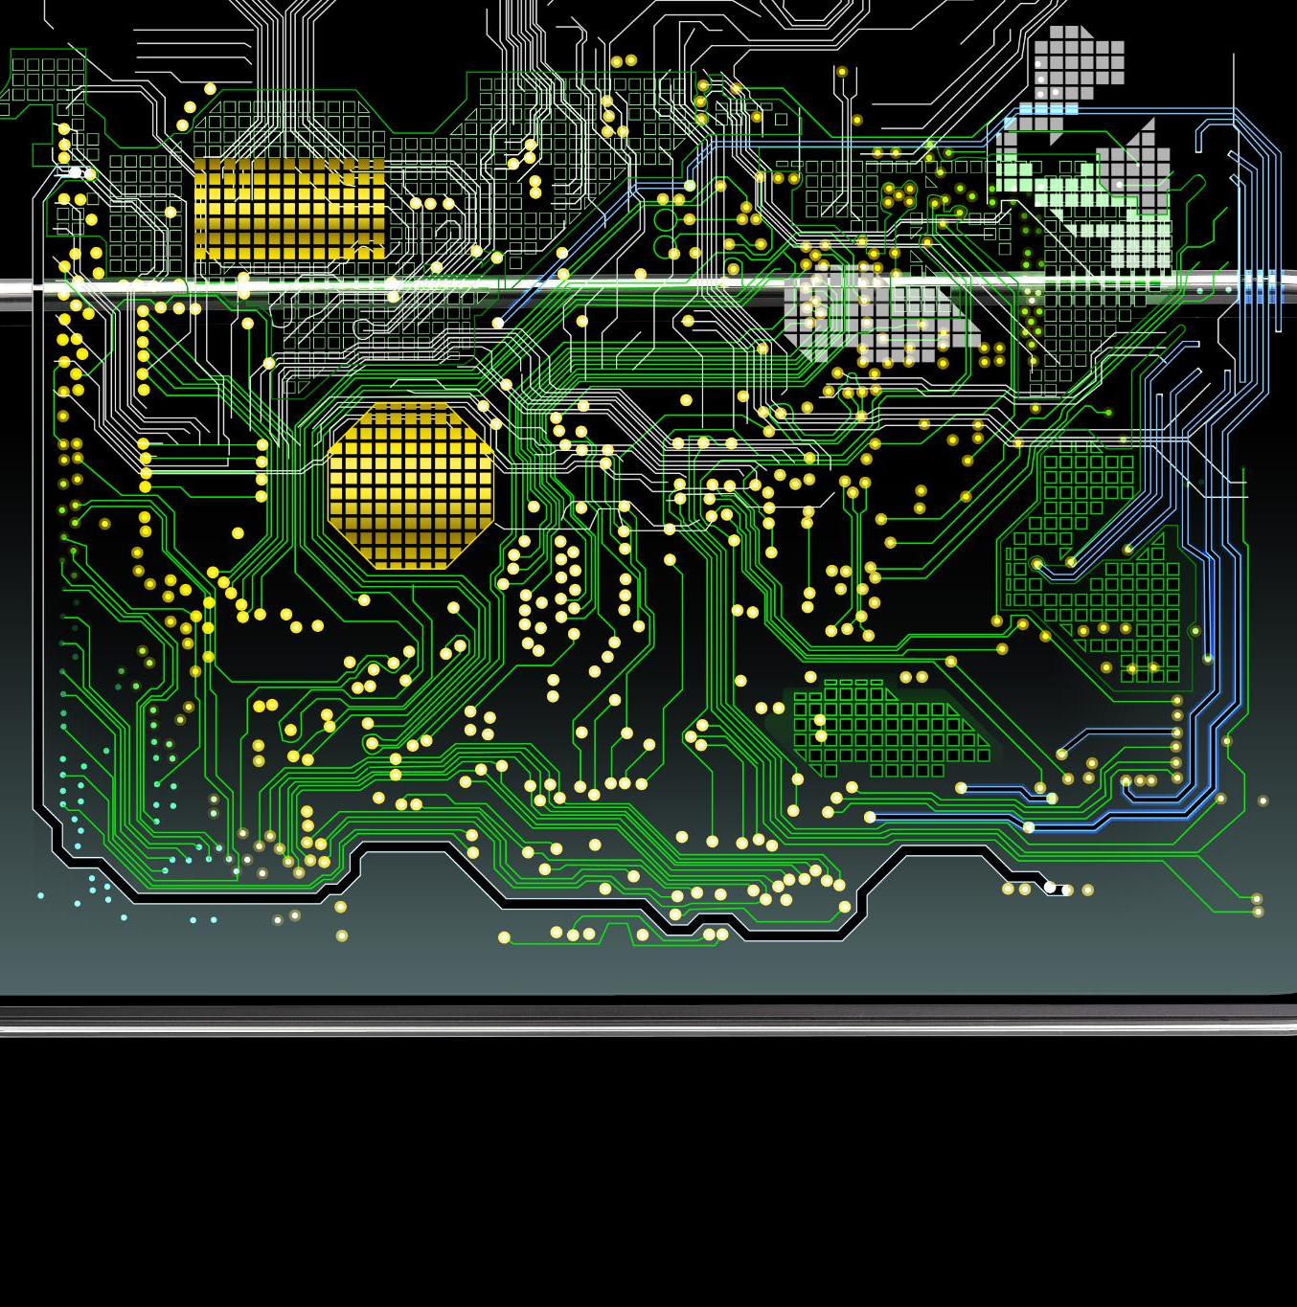
Integration: AI Memory Functions Mirror OS Efficiency and Adapt to New Tasks
AI Memory Integration
AI memory functions emulate the efficiency of operating systems by managing data effectively.
Operating System Efficiency
Operating systems optimize processes ensuring smooth, reliable, and efficient task execution.
Adaptive Task Handling
AI agents adapt seamlessly to new and complex tasks through integrated memory and learning.
Notes:
--- The integration of AI memory functions reflects the efficiency of operating systems, with adaptive capabilities that allow AI agents to handle new and complex tasks seamlessly. Image source: Microsoft 365 content library

Slide 17

Future Vision: Robust, Coherent AI-Human Interactions, Leading to Agents as Operating Systems of Thought
AI as Operating Systems of Thought
AI agents will function as advanced operating systems that support complex cognitive processes and decision-making.
Coherent and Robust Interactions
Future AI-human interactions will be seamless, context-aware, and reliable, boosting user experience and productivity.
Enhancing Creativity and Productivity
AI agents will augment human creativity and productivity by providing intelligent support and insights.
Notes:
--- Looking ahead, AI agents are envisioned as sophisticated operating systems of thought, enabling coherent, robust, and context-aware interactions that enhance human productivity and creativity. Image source: Microsoft 365 content library

Slide 18
Conclusion
Transformative AI Paradigm
Large language models with advanced memory reshape AI into an operating system paradigm, transforming capabilities and workflows.
Memory and Multitasking
Advanced agent memory enables efficient multitasking and dynamic learning, enhancing AI responsiveness and adaptability.
Redefining Interaction
AI agents managing security and learning redefine human-computer interaction with smarter, safer interfaces.
Notes:
In summary, large language models as operating systems with advanced agent memory represent a transformative paradigm in AI. By managing memory, multitasking, learning, and security like modern OSs, AI agents are poised to redefine human-computer interaction.

